Slide 1


SheShield
Empowering Women, Securing Safety.

Slide 2


Company Name
SheShield: Women Leading the Way to Safety and Security

Slide 3

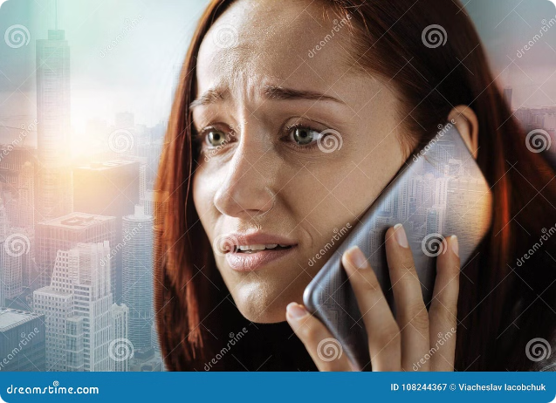
Problem
1
High Incidence
73% of women face online harassment.
2
Fear of Retaliation
Hesitant to report threats.
3
Inadequate Systems
Lack anonymity and timely response.
4
Lack of Global Reach
Fragmented systems leave many unprotected.

Slide 4

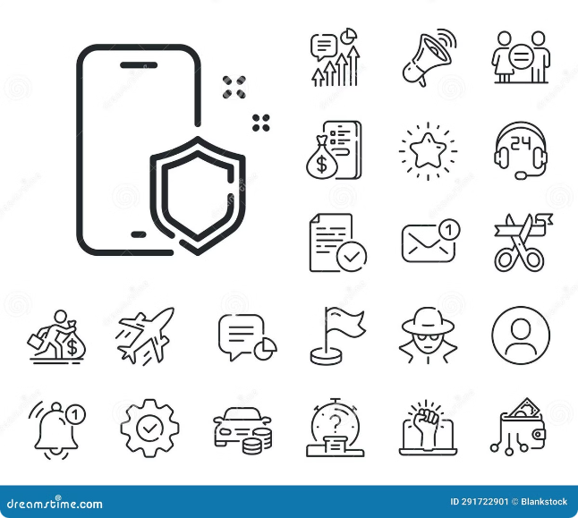
Solution
Decentralized Platform
Blockchain technology for anonymity and security.
Real-Time Reporting
Report harassment instantly and securely.
Direct Connection
Links users with law enforcement and experts.
Global Coverage
Universal solution with cross-border capabilities.

Slide 5


Benefits
1
Enhanced Safety
Anonymous reporting ensures user confidentiality.
2
Instant Response
Real-time connection with experts for prompt assistance.
3
Global Network
Comprehensive support network across borders.
4
Empowerment
Users regain control and confidence.

Slide 6


Assumptions & Validation Roadmap
1
Assumptions
Women need a secure, anonymous reporting system.
2
Validation Roadmap
Beta testing with select user groups and feedback collection.
3
Pilot Partnerships
Partnerships with NGOs and law enforcement agencies.
4
Global Launch
Expansion to full-scale global launch.

Slide 7
What Makes Us Special
Blockchain Technology
Real-Time Connectivity
Global Accessibility
Ensures untraceable and secure reporting.
Instant communication with experts and authorities.
Effective solution across different jurisdictions and borders.

Slide 8


Business Model
1
Subscription-Based Model
Premium features like priority incident response.
2
One-Time Fee
Quick access to dedicated expert assistance.
3
Partnership Commissions
Revenue from cybersecurity firms for referred cases.
4
Financial Contributions
Integrated payment system for additional support funding.

Slide 9


Market
1
Market Size
Digital safety and cybersecurity market projected to reach $20B by 2028.
2
Target Audience
Over 1 billion women worldwide facing digital harassment.
3
Growth Potential
Increasing awareness and regulatory focus on online safety and women’s rights.
4
Competitive Advantage
First-to-market with blockchain-powered anonymity and global response capabilities.

Slide 10

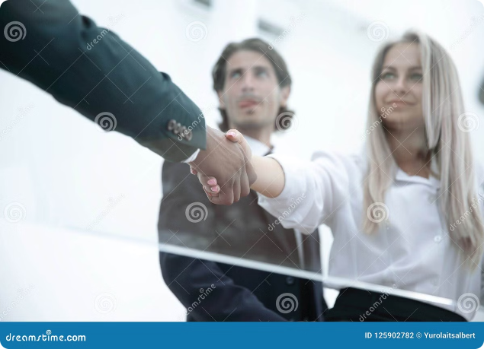
Sponsorship Ask
Funding Request
$1.5 million for a 10% equity stake.
Strategic Support Needed
Connections, expert guidance, corporate partnerships.
What We Offer
Equity in an innovative product with a growing market, co-branding opportunities, partnership in a high-impact mission.

